Slide 1
Using Graphs, Tables, Charts, and illustrations in Technical Reports
Effective Visuals
S. Last ENGR 120

Slide 2
VISUALS
Capture and hold people’s attention
Help illustrate textual information
Simplify complicated textual descriptions
Help the reader understand complicated systems, processes, and mechanisms.

Slide 3
TYPES OF VISUALS
Visuals are referred to as either TABLES or FIGURES.
TABLES contain detailed data/information formatted in rows and columns for comparison.
FIGURES can take many forms and include
Graphs
Charts
Illustrations

Slide 4
When to use each
Tables show the most amount of detail but require study. Use a table when detail is needed; refer to the details in the text, and if necessary, move the table to the appendices.
Figures such as graphs and charts illustrate trends or contrast more dramatically but lose the detail. Make the point with the graph, but back it up in the text.

Slide 5
Principles of Effective Visuals
Simple Design: make visuals clear, easy to understand; don’t over-complicate them.
Not“decoration”: visuals perform a useful function, they don’t just decorate your document
Clarifies/Illustrates: supplements, does not “replace” textual information

Slide 6
PRINCIPLES, continued
Number and caption every visual sequentially
Tables and Figures are numbered separately
Captions should be brief, accurate, and informative
Discuss each visual in the text
Refer reader to the visual by number
place visual as soon as possible after the reference
Present all visuals in an appealing manner
Don’t crowd them by the text or squeeze in between other visuals
Use white space to enhance readability

Slide 7
PRINCIPLES, continued
Clearly label all elements of a visual (legends, axes, scale, direction, etc.) and provide a “key”
Point of view should match that of the reader performing illustrated procedure
Never omit, distort, or manipulate information to deceive or mislead
Avoid spelling mistakes, poor grammar, inconsistent formatting, in labels, key, title or accompanying text
Cite the sources of visuals you did not create yourself

Slide 8
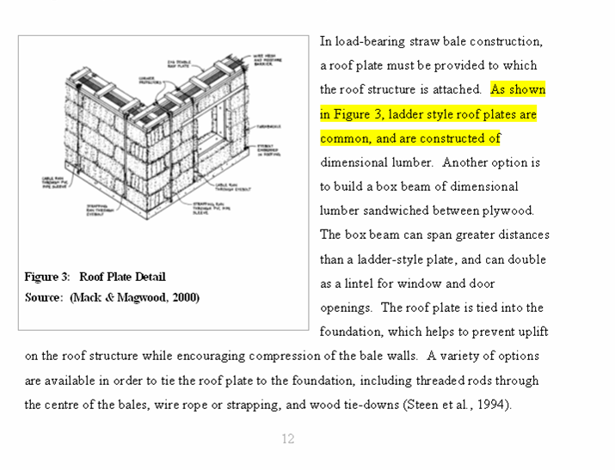
Discuss all Visuals in text
Refer reader to the visual by number
place visual as soon as possible after the reference

Slide 9
TABLES
Portray detailed statistical and other information for comparison horizontally
Consist of horizontal rows and vertical columns
Top row holds the column headings and is called the BOXHEAD; specify unit measurements in boxhead rather than in each cell
Leftmost column holds the row headings and is called the STUB
Table captions must go above the table
Align columns according to the material in the cells: left align text, right align numbers, left align combinations
Explain key points of the table; refer to tables in nearby text, and explain the significance

Slide 10
Sample Table Table 1. Comparison of Materials and Costs for Designs A and B
Design A |  | Design B
Materials | Cost | Materials | Costs
TOTAL COST
Note: Type in boxhead is usually centred and bolded to distinguish it
from the data in the table and enhance readability.

Slide 11
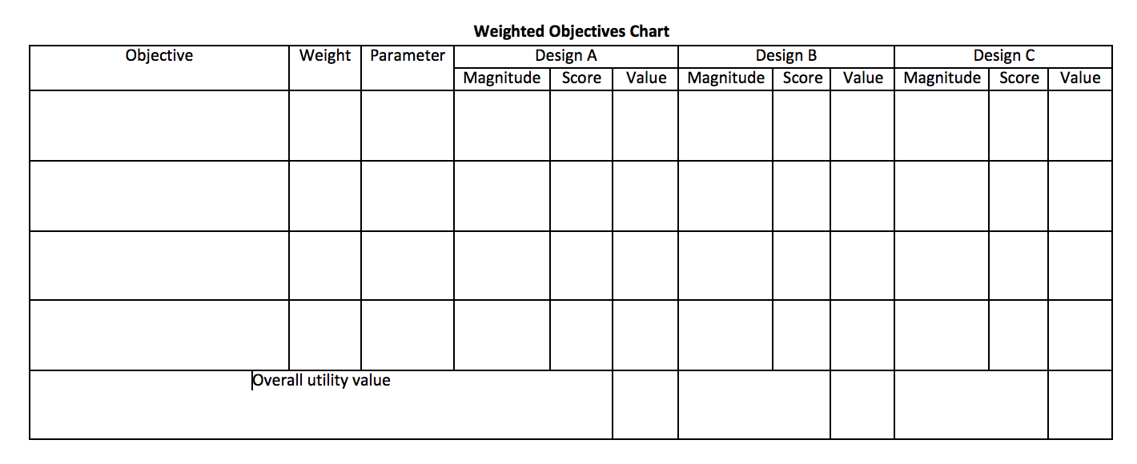
Weighted Objectives Table

Slide 12
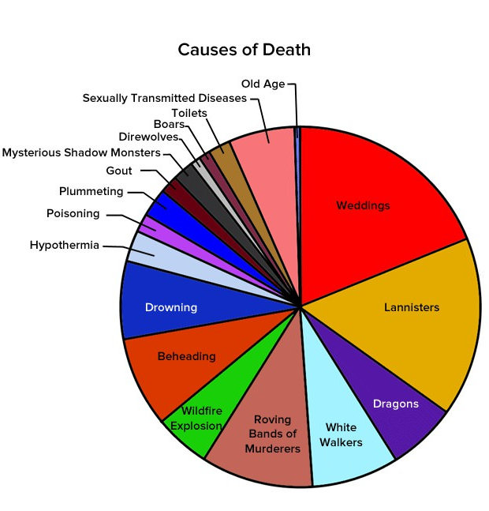
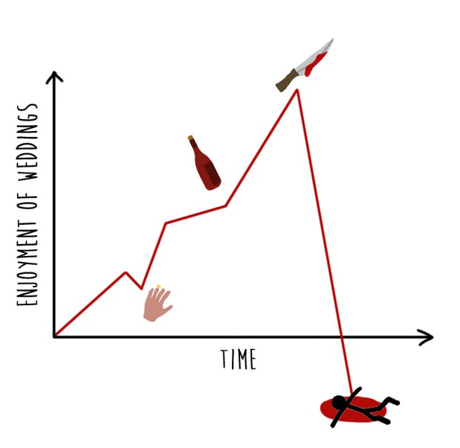


TYPES OF FIGURES
Graphs
Line graphs
Bar graphs
Charts
Flow charts
Pie Charts
Organizational charts (Gantt charts)
Illustrations
Photographs
Diagrams
Drawings

Slide 13
GRAPHS
Line Graphs and Bar Graphs
Display statistical trends, changes, and comparisons
Line Graphs
Portray change over time
Plot points along horizontal and vertical axes
Join points by means of straight line
Horizontal axis identifies the categories of information
Vertical axis identifies incremental values that are being compared
Additional lines can be added for comparison

Slide 14
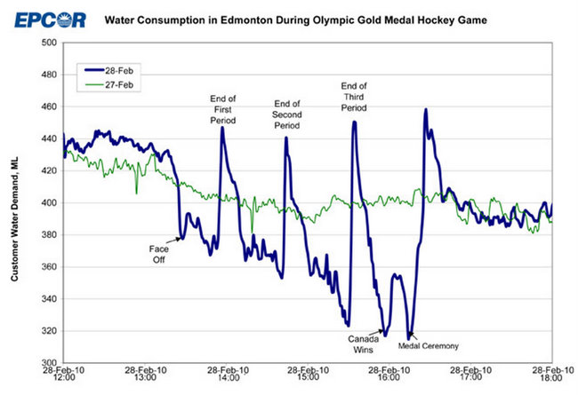
Sample Line Graph
Caption
Legend
Captions
for key
data
Points
X axis
Y axis

Slide 15
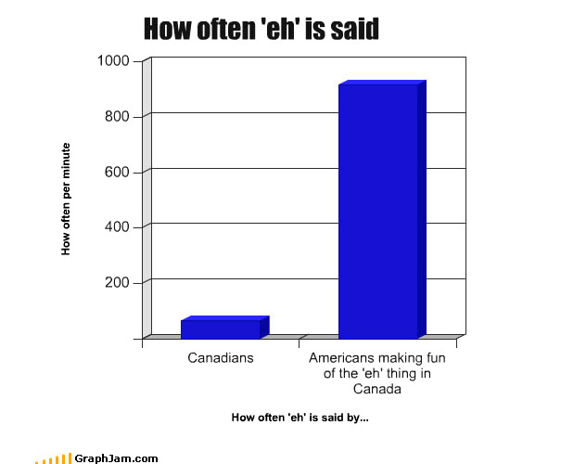
Sample Bar Graph
Figure 1. Comparison of how often Americans vs Canadians say “eh”

Slide 16
Bar Graphs
Consist of horizontal and vertical axes that depict dependent and independent variables
Which axis depicts which variable is determined by whether bars are horizontal or vertical
Horizontal bar graphs are useful for accommodating many bars and have room for labels if titles are lengthy

Slide 17
CHARTS
Portray quantitative, cause-and-effect, and other relationships among parts of a unified whole
Can depict
Steps in a production process
Chain of command in an organization
Sequential or hierarchical interactions

Slide 18

Flow Charts
Used to portray the steps through which work must flow
Read from top to bottom or from left to right

Slide 19
Organizational Charts
Portray chains of command within organizations
Most powerful positions placed at the top
Least powerful positions placed at the bottom
Portray relationships between elements (can be non-hierarchical)
Gantt Charts – project management tool showing when all tasks are to be done in a project over a period of time

Slide 20
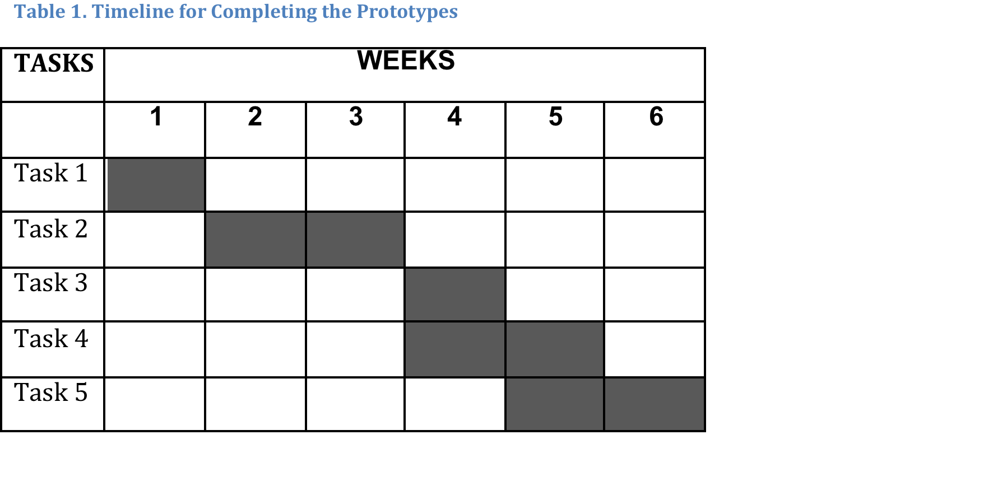
Sample Gantt Chart

Slide 21
Pie Chart
Pie Or Circle Charts – depict relationships among parts within statistical wholes
Often used to show the percentage distribution of budget or resources
Should have at least 3, but no more than 7, segments resembling slices of pie and constituting a percentage
Each slice labeled, showing percentage of the total

Slide 22


Non-Optimal Pie Chart
Figure 4: Causes of death in Game of Thrones
Figure 3: uses of semicolons

Slide 23
ILLUSTRATIONS
Illustrations such as photographs and diagrams help the reader to understand what you explain in your text. Some documents that NEED illustrations include
Instructions
Need to show the components of the objects involved, and the orientations between the objects and the tools
Technical background reports
Need to use diagrams and drawings, photographic evidence, conceptual drawings with maps, etc.

Slide 24

Photographs
Exact representations; strictly accurate
Provide overall-view
Required in certain types of documents
Try to make photo as clear and high quality as possible
Figure 5. Shimano Road Bike Drive Train

Slide 25
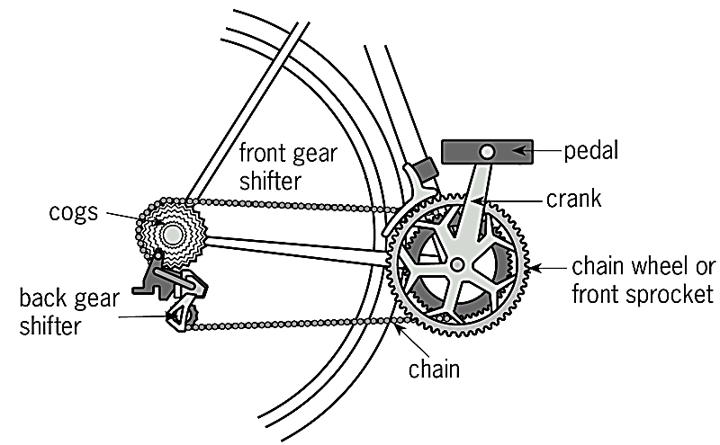
Diagrams
Simplified, realistic depictions of objects or specific aspects/details
Portrays what is most relevant and clarifies information; focuses on important features
Figure 6. Bicycle drive train

Slide 26
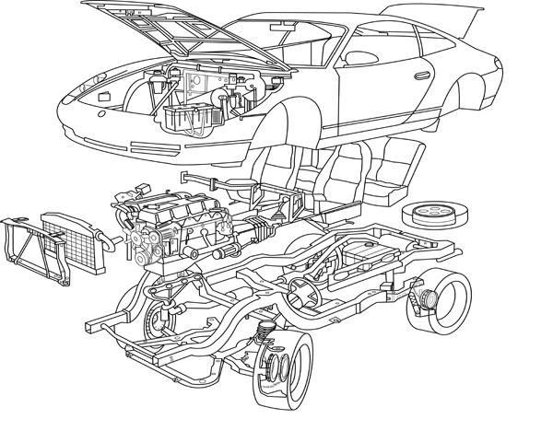

Kinds of Diagrams
Figure 7. Conventional line drawing
Figure 8. Exploded View

Slide 27


Kinds of Diagrams
Figure 9. Cut-away diagram
Figure 10. Clip art

Slide 28

Kinds of Diagrams
Figure 11. Venn diagram

Slide 29
When using Visuals
Simplify your illustrations
Use computer applications critically
Number and caption your illustrations
Discuss your visuals in the text
Position your illustrations strategically
Avoid distortion, misrepresentation and deception
Identify your sources.

Slide 30
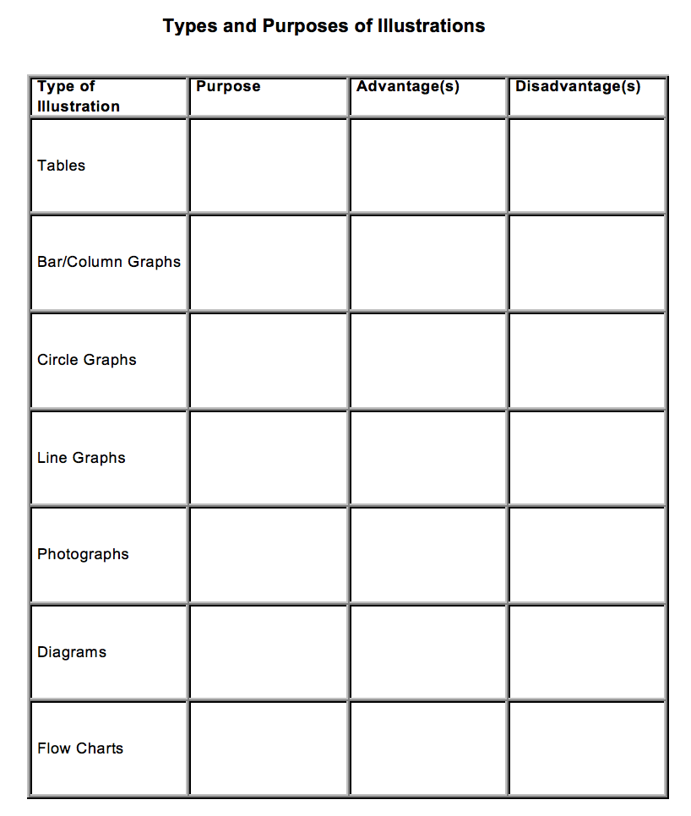
Use the right visual for your purpose and audience.

